Slide 1
Search
SEARCH
Keywords
Category
Go
Toolbox
Filters
Filter
Filter
Stops
Search
Search
Search Companies
Go
nonstop $319
1 stop $340
2+ stops $375
Destination or...
GO
Refine By reset
6/18/2011
6/18/2011
Location
-
Flight Times reset
Keyn
Keynote
Keynotopia
Keynote templates
Keynote speaker
Search
Advanced
Headquarters only
Rental Rates (in $USD per week)
Take off
Landing
All Locations
United States
United Kingdom
San Francisco Bay Area
Netherlands
Greater New York City Area
Show more...
Depart Flight show all
$1,500
Sun 5:30a
Sun 9:45p
$500 or less
$10,000+
Bedrooms
Sleeps
Return Flight show all
Enter location name
2+
Any
Sun 5:30a
Sun 9:45p
Property Type
Search sales for 228,452 stores...
Search
Job Opportunities
+
Condos
Cabin
e.g. home depot eddie bauer gift baskets macys vistaprint gift cards christmas
Industry
+
Location Type
Economy $319
First $340
Relationship
+
Beach Rentals (2)
Downtown Rentals
Lake Rentals
Mountain Rentals
Ocean Rentals (1)
River Rentals
Airlines reset
Company Size
+
American Airlines $319
Continental $340
Delta $375
US Airways $375
REFINE YOUR
SEARCH
FEATURES
SIZES
SORT BY
PREVIEW GRID
3x2 4x3 6x4
Number of Followers
+
XXL
Fortune
+
Star Alliance SkyTeam oneworld
Airline fees
XL
M
More Filters
Sites

Slide 2
Search
Who
Show all
Guys
Girls
SHOWING
PRICE
Babies
Kids
Xbox 360 X
Narrow your results
Hide Filters
Showing 1-25 of 290
Collection
Games X
$369
$879
In Digital Cameras
Clear all refinements
View all
Action X
STOPS
Threadless
Select
Non-stop $449
Brand
any
Aspect Ratio
16:9
Megapixels
Type Tees
Clear all selections
1 $384
8.0 to 9.9 MP
NARROW RESULTS
TIMES
View in grid
alaScore
Type
LCD TV
Choose more I Clear
Size
View all
Specials
Leave: Depart I Arrive
Brand
XS
S
M
L
Bonus Item (14)
Type
XL
2XL
3XL
Pre-Owned Games (277)
06:00a 4:35p
Price
Diagonal Size
any
Condition
Price Drop (7)
Leave: Depart I Arrive
New (564)
Style
Value Priced (127)
New other (see details) (82)
View all
Action
06:00a 4:35p
Resolution
Combo Box
Show local products only
Manufacturer refurbished(14)
Tees
Hoodies
Adventure(211)
AIRLINES
Seller refurbished(56)
Other Tops
Pullovers
Crime (23)
Used(1,352)
Tanks
Fight (7)
American
For parts or not working (409)
Horror (40)
Continental
Refine Results
Not specified (102)
Platform (23)
Delta
Choose a digital camera
Choose more
Price
View all
Tactical (7)
Sort by
$120 to $280 [x]
Compact [x]
Price
$5
$10
$14
$15
ESRB Ratings
Frontier
Most Popular
Product Brand
Resolution (Mpix)
Optical Zoom Ratio
Also filter by
150$
to
990$
$20
$24
$39
Everyone (41)
JetBlue
Panasonic (31)
1 to 10 (31)
3 to 4 (31)
Image Stabilization
CLEARANCE
Everyone 10+ (99)
US Airways
Platform
Sony (24)
10 to 12 (24)
4 to 5 (24)
Touchscreen
Optical Zoom
Teen (189)
United
Canon (32)
12 to 14 (32)
5 to 10 (32)
3D
Mature (162)
Multiple Airlines
Community
Samsung (28)
14 to 50 (28)
10 to 24 (28)
Media Format
Bundled Items
Color
View all
None (3)
show all...
show all...
Seller
Rating pending (40)
AIRPORTS
Version
Digital Cameras that match your criteria (158)
Buying formats
All
Show only
FLIGHT QUALITY
Location
DURATION
Show only
Trusted Extensions
Distance
Show all
Customize preferences
Search within
New Search
Filter your flight results
basic filter
advanced filter
hide filter
Search
Filters
Reset
CATEGORY
Televisions
PANEL TYPE
Plasma
SCREEN SIZE
FORMAT
1080p
PRICE
Filters Applied: Stops I Airlines
clear all filters
Price Range
Stops
Airports
Airlines
less than 32 inches
Non-stop
Showing All
JetBlue Airways
32-40 inches
$0
--- to ---
$260
Flight Times
Departing Flights
Departing Flight Take-Off Time
Departing Flight Landing Time
40-50 inches
Update Price Range
Returning Flights
50-60 inches
Sun 6:00a
Sun 5:20p
Sun 6:00a
Sun 5:20p
more than 60 inches

Slide 3
Sign up
Sign up
Terms of Service
Quickly sign up with:
Agree And Consent to Our
Terms Of Service, Privacy Policy, and EULA:
I Agree
I Do Not Agree
facebook
Google
Yahoo
FIRST NAME
LAST NAME
OR
EMAIL ADDRESS
E-mail address:
johnonno@example.com
COUNTRY
Choose a password:
PASSWORD
*******
CONFIRM PASSWORD
I have read and agree to the
Terms of Service.
I’d like to receive your newsletter.
Sign Up
I have read and agree to the Terms of use.
Already have an account? Log in here
Sign Up

Slide 4

Sign up
SIGNUP FOR PRO
Create A New Account
It’s free. Everyone can join.
Application PRO
$4.95/month
Your account address:
This will be a web address to access your account.
http:// .example.com
Contact Information
Billing Address
Login name:
First Name
Street Address
Last Name
City
Password:
Email Address
State
Zip
Re-type Password:
Additional Info
Country
Email:
Company
We will send account confirmation link to this address.
Order Overview
Your Name:
Application PRO
$4.95/month
Billing Method
Enter numbers shown below:
Card Number
SUBMIT FORM
Card Expiration Date (mm/yyyy)
Card Verification Code
By submitting this form you agree to our Terms of Service.
Create Account
Already have account? Login.

Slide 5
Login
Log in to your account
SIGN IN
LOGIN TO APPLICATION
Sign in to keynotopia.com with your Keynotopia ID.
Email Address
Username
Email address
Password
Keep me logged in
Password
Forgot it?
Password
Remember me on this computer
Remember me I
Forgot password?
Log In
Login
I’ve forgotten my password
New to Example? CREATE ACCOUNT
Cancel
Sign In
Welcome to
Website Name!
Username
Password
Remember?
GO
Login to website
AUTHORIZED USERNAME
username
Please sign in to your
account to get started.
password
Login with Facebook
Login with Twitter
Need an account?
Reset your password?
SIGN IN
Email Address
Password
LOGIN
Forgot your password?

Slide 6
Subscribe
SIGN UP FOR 1234 NEWSLETTER
Newsletter Sign Up
just enter your email below:
Username !?
Password !?
4 errors prohibited this user from being saved
There were problems with the following fields:
• Login can’t be blank
• Login is too short (minimum is 2 characters)
• Password is too short (minimum is 5 characters)
• Email format
SIGN UP
dsds !?
Not a valid email address!
sign up for hohemia news
and receive 10% off your next order!
contact us for expert advice
Monday to Friday 4am to 12pm EDT
tel: +44 555 111 4444 or email us
By clicking sign up,
you agree to the Terms of Use.
SIGN UP
Email
Enter Email Address
Send me occasional news & tips.
abcd
Username
Join the Mailing List
LOGIN
Forgot password?
Get useful tips and articles on website design, email marketing and social
media plus the low-down on recent projects and new clients.
NEWS / EVENTS
Please enter a valid email address.
Password can’t be blank.
Email
Subscribe
Keep up-to-date with latest info on the
interesting news and happenings.
First Name
Email
sdsdsds
First Name
Last Name
Last Name
Password
! Please enter your first name.
! Please enter your last name.
LOG IN
Remember me
Email Address
Email
! Please enter a valid email address.
Join the Example email list
Submit
Submit
Name
Email

Slide 7
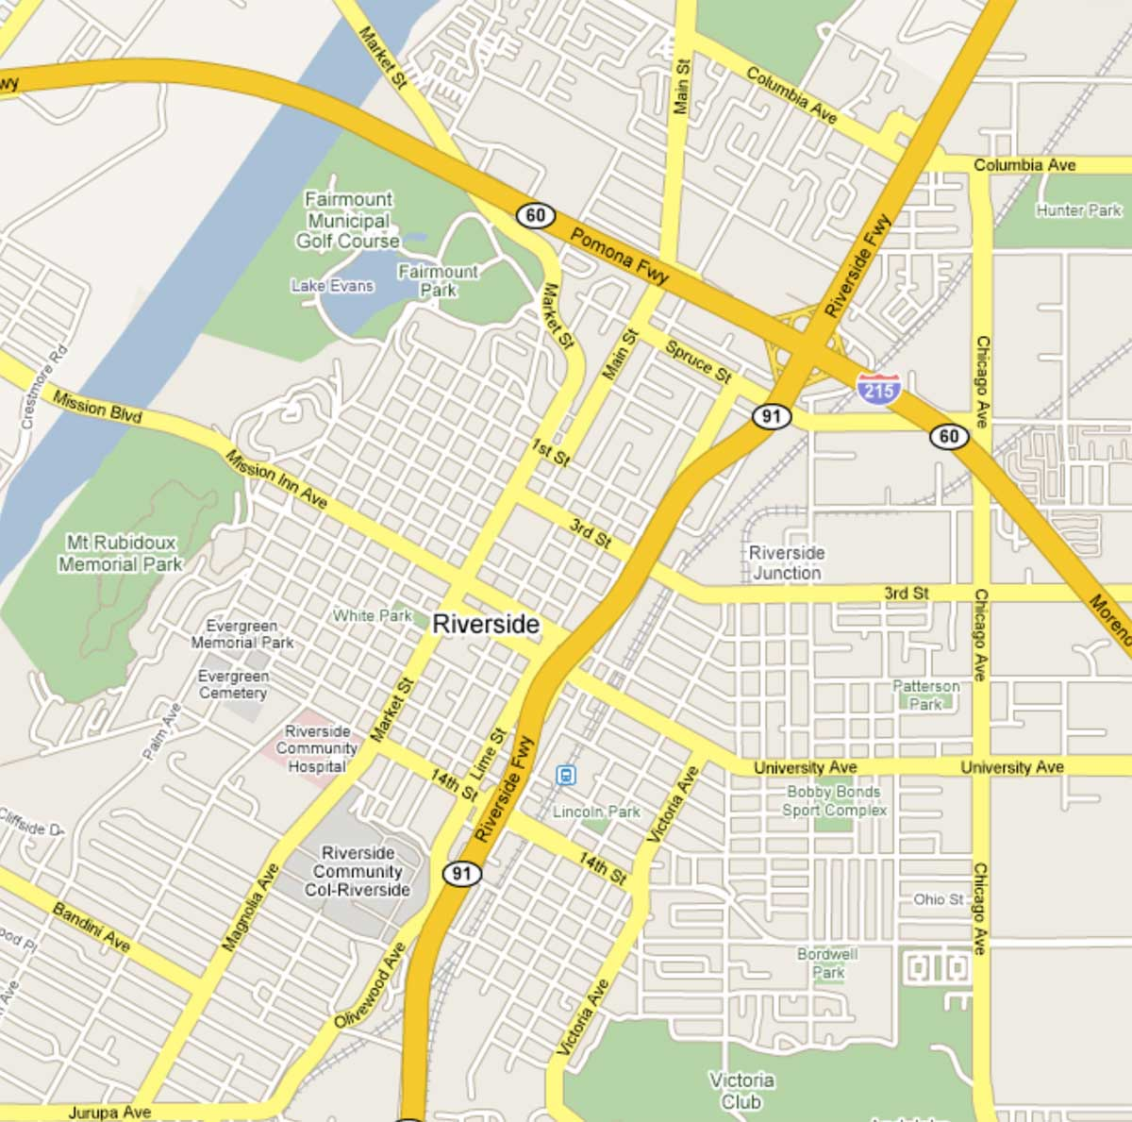
Popups
Ratings
64
out of 100
Metascore
Generally favorable reviews
based on 34 Critics
What’s this?
Help those kids
Non-Profit Organization
Austin, Texas
7 friends like this
RATING
Editors’ rating:
4.7
based on 3,021 reviews
Very good
Detailed editors’ rating
DESIGN:
8.0
Average user rating:
Example
Rating
FEATURES:
9.0
7.4
✓ Liked
PERFORMANCE:
7.0
out of 22 reviews
See all user reviews
Very Good
6.4
User Score
Generally favorable reviews
based on 32 CRatings
IMAGE QUALITY:
8.0
Rating explanation
Experience
Industry Recognition
What’s different?
Now you can choose up to 5 different options for your purchase!
Professional Conduct
(20 reviews)
Find out more about the Example Rating
(11 reviews)
(11 reviews)
(05 reviews)
Close
(05 reviews)
Average Client Rating
Example.com Score
3.4
fair
Critic Score
12 reviews
3.0
14 reviews
User Score
75 votes
3.7
72 people have voted
Former client?Write a review
Username
1,215 Followers
Follow
83%
like it
Endorsements
Your Score
2.0
Reset
2 endorsements
About the rating system
REVIEW THE GAME
Lawyers: Endorse this lawyer
Add your vote
“If anyone needs to make a survey for any reason at all YOU MUST try Example!”
Add to your wish-list
John Smith, example.com
AVERAGE USER RATING:
86.6%
85 out of 92 Example customers said that they would
recommend “This Hotel in Orleans”
10
Gameplay
Graphics
Atmosphere 80.8%
Facilities 80.0%
Staff 91.2%
Safety 86.4%
WRITE A REVIEW!
Sound:
Location 91.2%
Cleanliness 89.6%
Value 87.2%
Read all 5 reviews

Slide 8
Navigation
Find Rates
Deals
Reviews
Tools
Banks
Plan a trip
Manage flights
Where we jet
Flying on Jet
Travel information
Special
Offers
All
Headlines
What customers say
Snacks & Drinks
Radio
Movies & More
More Offers
Wi-Fi
Shut Eye service
Customer protection
Economical News
Hot
News
Rates &
Trends
Credit
Family
Finance
Technology
36 channels of
live TV at every seat
All Your Favorite
Shows
More Entertainment
Deals
Claim Your Free
Gift Now
Video
News
Pubs
Articles
PRODUCTS
SOLUTIONS
RESOURCES
CUSTOMERS
TOUR
ABOUT US
Editorial
Help Wanted
Archived Edition
YOU ARE HERE
WORK
Home
Gifts
Wooden Dolls
HOME
ABOUT
CONTACT
Submit a Press Release
Post a Job
Onboard Experiences
Entertainment and Activities
Seaside Theatre
Home
Gifts
Wooden Dolls
01 SPRING HOME
Home
/
Middle Page
/
Another one
/
You are here
02 KIX BROOKS STORY
My Website
03 SPRING JUBILEES
My
shop
kitchen
dishwashers
04 WINE AND DINE
DETAILS ➙
➙ THINGS TO DO
AGENDA ➙
SPEAKERS ➙
06 MULTIMEDIA
SPONSORS ➙
SHOP / SWIMWEAR / Classic Swim trunk
07 PREPLANNED TRIPS
08 INTERACTIVE
MENU

Slide 9
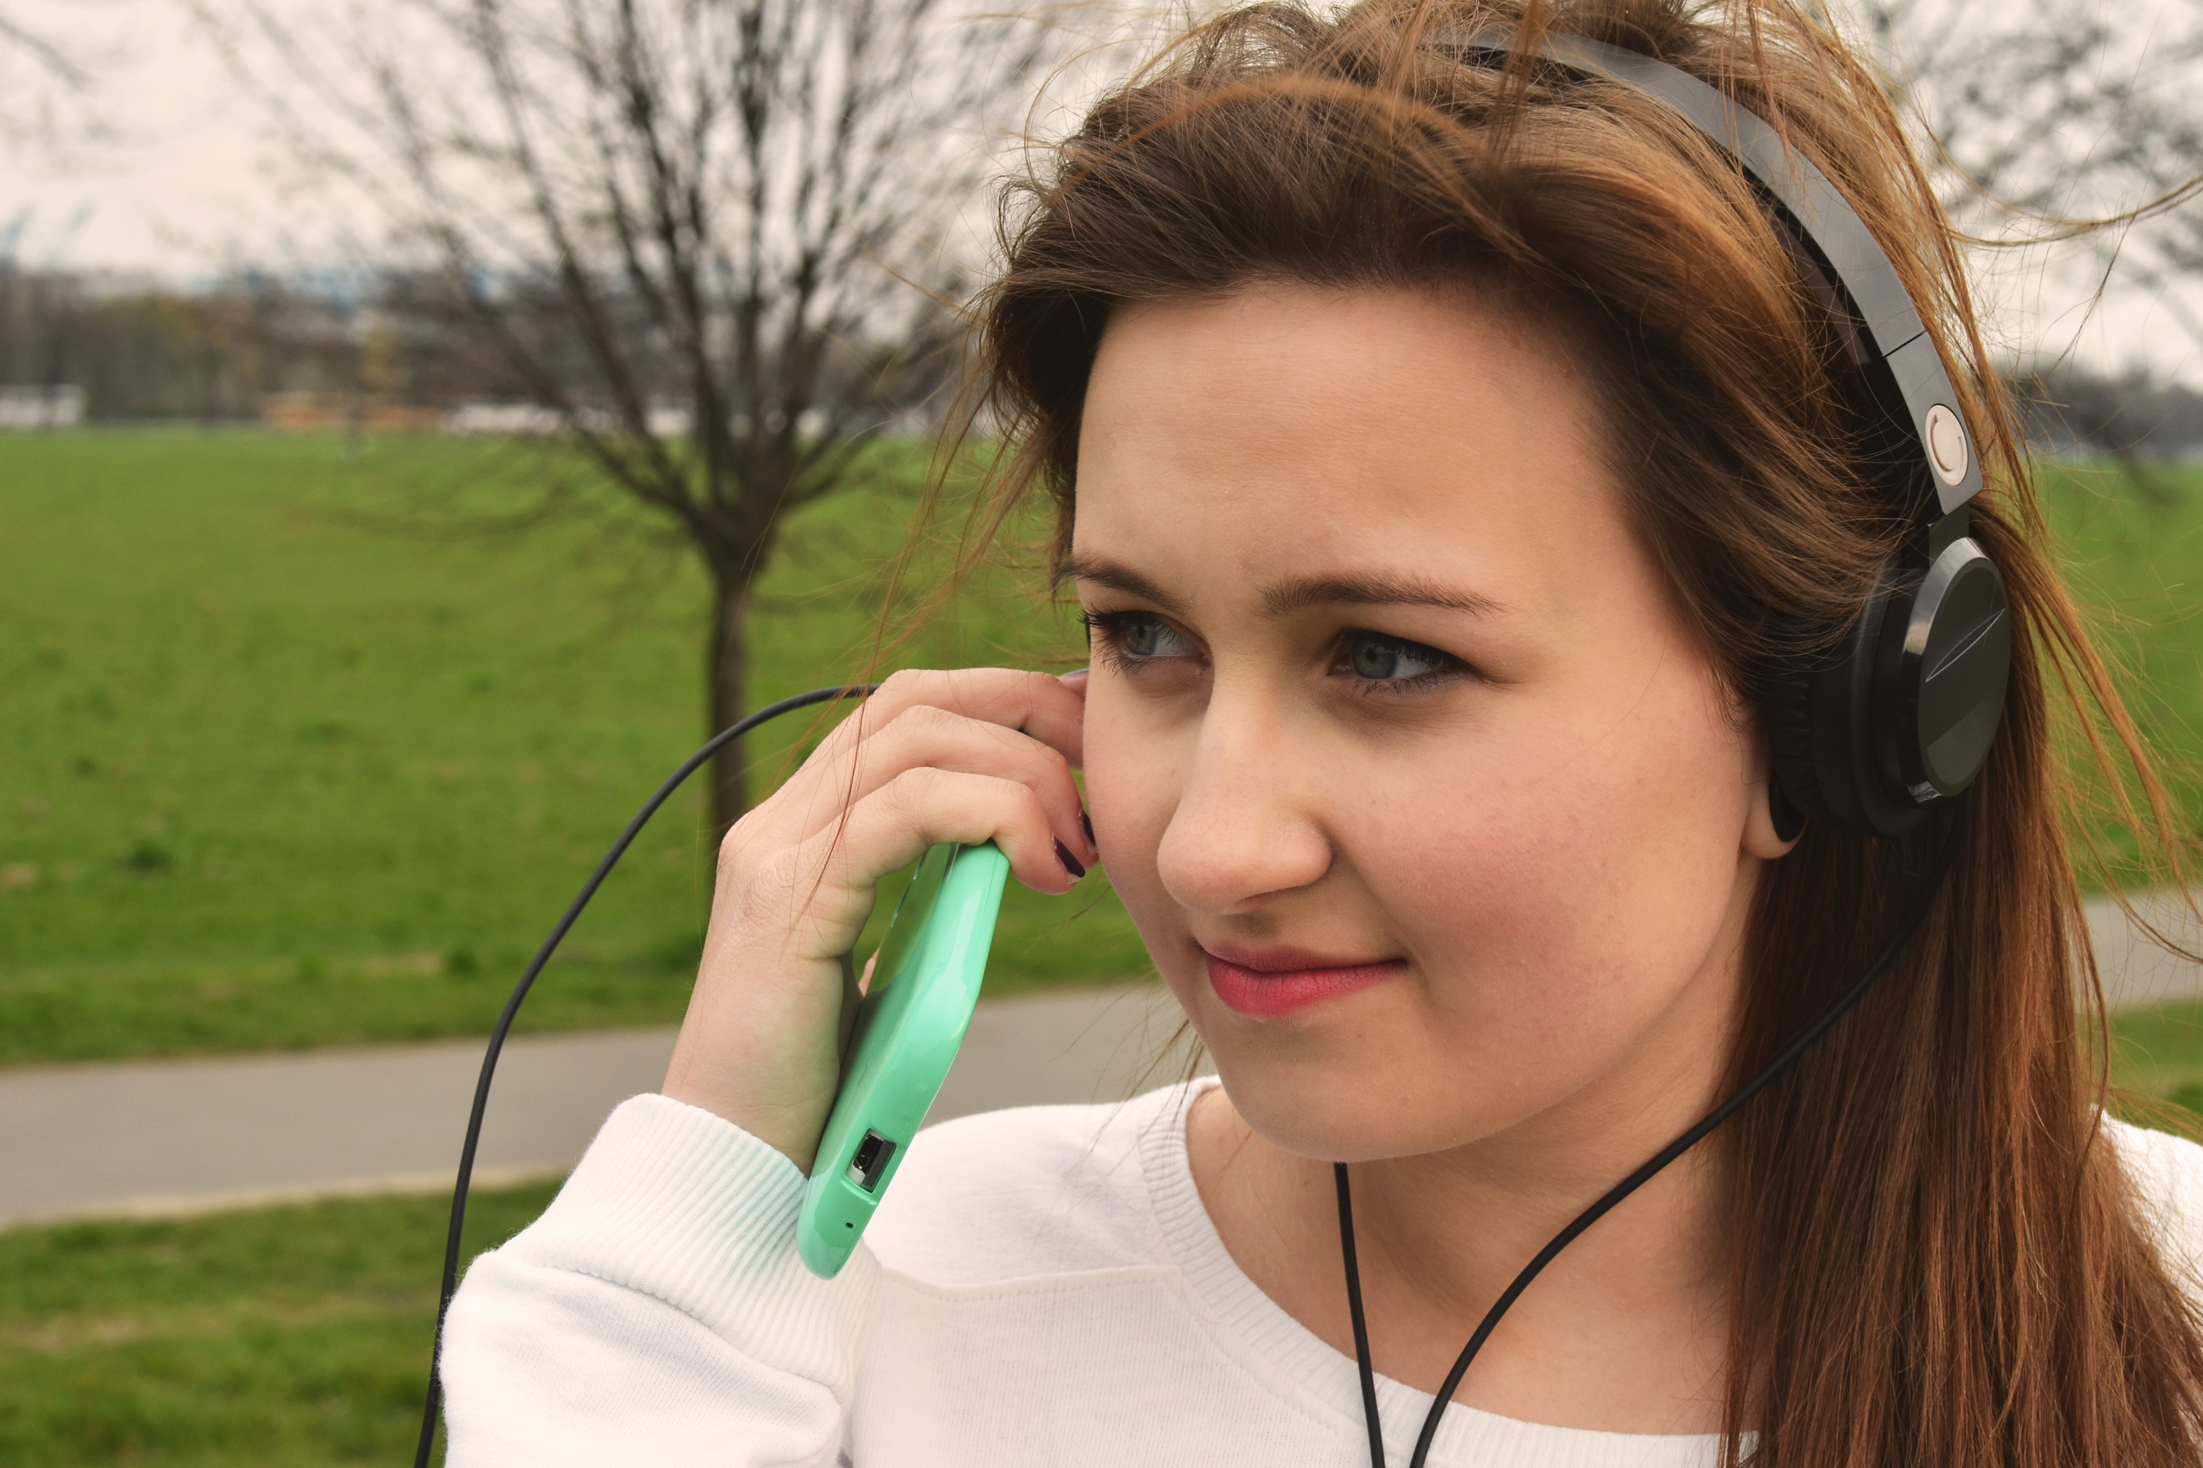



Video players
3:41
HIGH
LOW
3:41
HD
+1
Like
8
00:34
00:54
01:14
01:34
3:41
300k
full screen
+
00:15:13 / 00:48:29
PROGRESSIVE 00:00:03
00:01:14
MENU

Slide 10
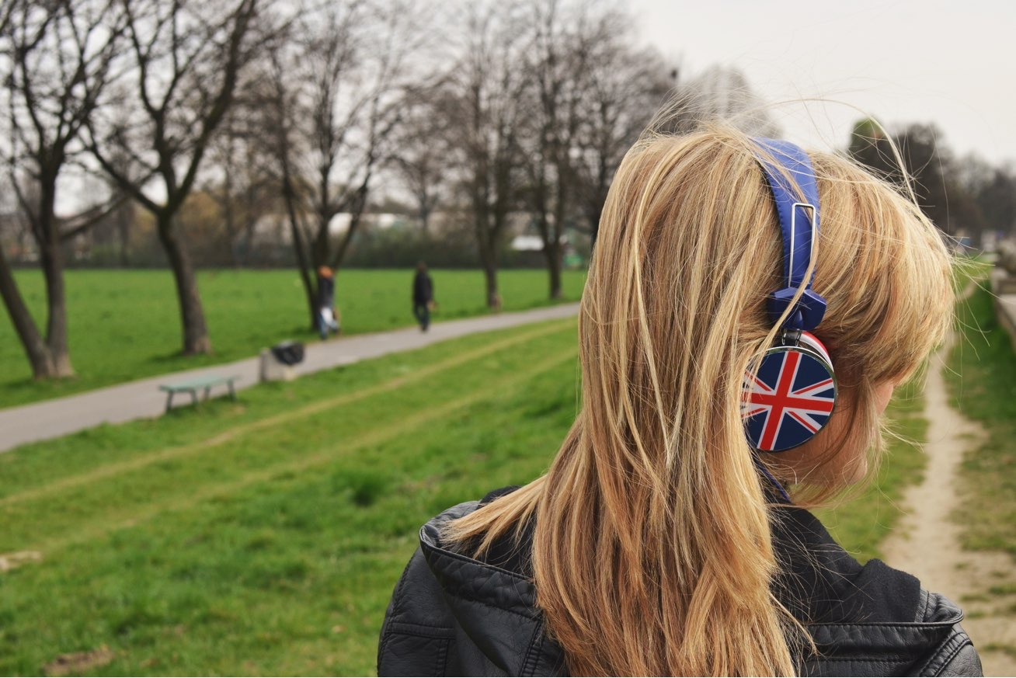

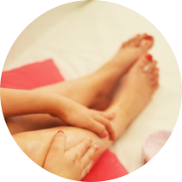


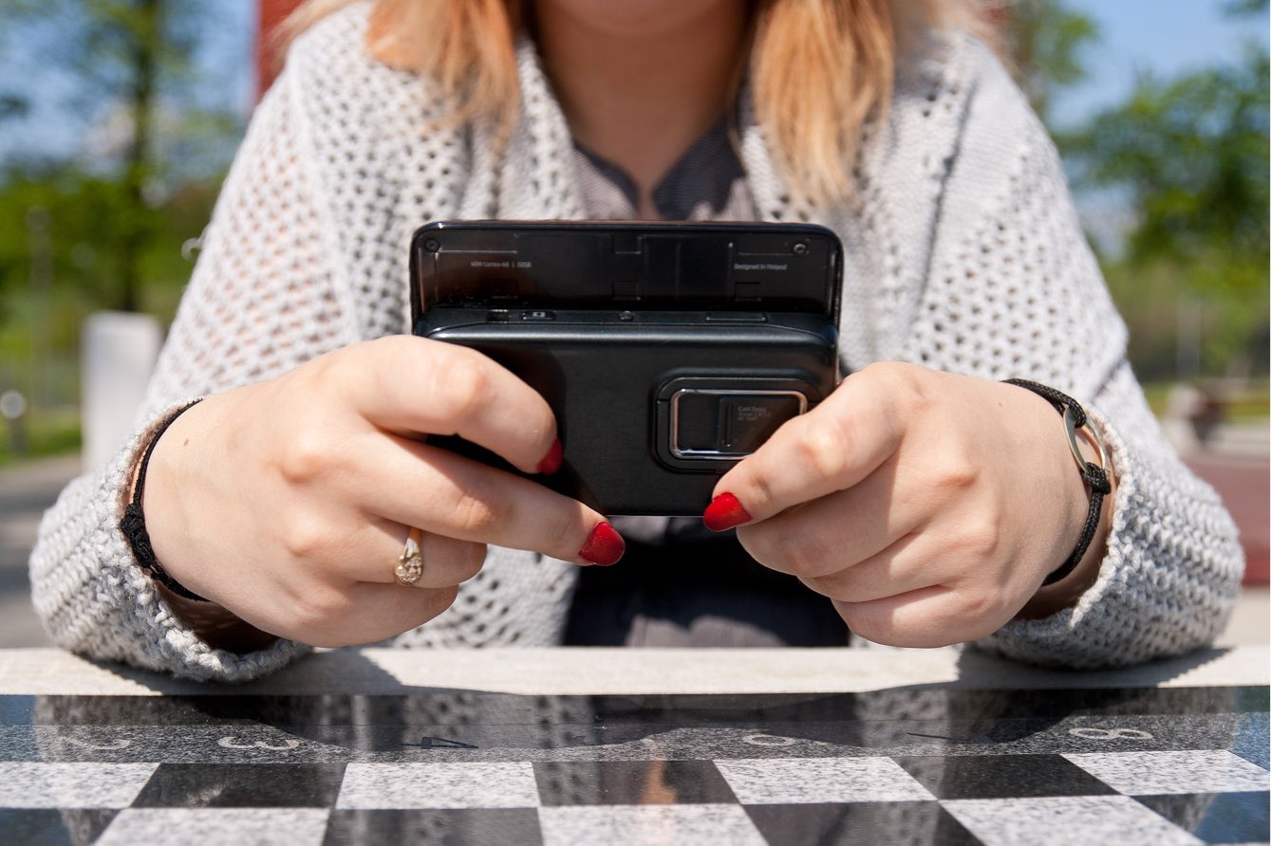






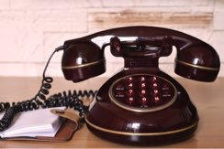


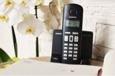
Media Galleries
Today on Keynotopia, watch new libraries in action...
Save up to
60% Instantly
on select Supplies
Stock up and get organized.
Shop now
Great shoes!
Select your size
Great skirts!
Choose your color
New hats!
Choose your style!
1
2
3
Prev
1
2
3
4
5
Next
The New
Adventures of
Old Christine
Monday, February 25
9.30pm et/pt
Christine promises to accompany Mr. Harris to an important event, but
leaves him hanging when...
Get all the details >
Celebrity Lastname: Model to mogul
She’s got five hit songs, and she’s buidling a multimedia empire...
June’s Best iPhone and iPad Games
Get the details on the month’s best new releases for the iPhone and iPad,
including two soccer titles and a pair of retro-styled platformers.

Slide 11
Calendars
21
Prev
November 2011
Next
Select Month
Today is: Thursday, July 05
Depart date
Return date
Sunday
Monday
Tuesday
01
Wednesday
Thursday
Friday
Saturday
tue
02
03
04
05
July 2012
July 2012
Siegfried
6:00 PM
Nabucco
7:30 PM
Don Giovanni
7:30 PM
Satygraha
7:30 PM
Siegfried
12:00 PM
S
M
T
W
T
F
S
S
M
T
W
T
F
S
SiriusXM Live
Broadcast:
Siegfried
Nabucco
9:30 PM
July 2012
1
2
3
4
5
6
7
1
2
3
4
5
6
7
SU
MO
TU
WE
TH
FR
SA
8
9
10
11
12
13
14
8
9
10
11
12
13
14
06
07
08
09
10
11
12
1
2
3
4
5
6
7
15
16
17
18
19
20
21
15
16
17
18
19
20
21
Siegfried
6:00 PM
Nabucco
7:30 PM
Satygraha
7:30 PM
Siegfried
12:00 PM
8
9
10
11
12
13
14
22
23
24
25
26
27
28
22
23
24
25
26
27
28
Nabucco
9:30 PM
15
16
17
18
19
20
21
29
30
31
29
30
31
SiriusXM Live
Broadcast:
Siegfried
SiriusXM Live
Broadcast:
Nabucco
22
23
24
25
26
27
28
29
30
31
Flights available for sale through February 13, 2013
13
14
15
16
17
18
19
Siegfried
6:00 PM
Nabucco
7:30 PM
Satygraha
7:30 PM
Siegfried
12:00 PM
SiriusXM Live
Broadcast:
Siegfried
Nabucco
9:30 PM
OCTOBER 2011
←
→
August 2006
SU
MO
TU
WE
TH
FR
SA
Mon
Tue
Wen
Thu
Fri
Sat
Sun
20
21
22
23
24
25
26
1
2
3
4
5
6
Siegfried
6:00 PM
Nabucco
7:30 PM
Satygraha
7:30 PM
Siegfried
12:00 PM
1
7
8
9
10
11
12
13
SiriusXM Live
Broadcast:
Siegfried
Nabucco
9:30 PM
2
3
4
5
6
7
8
14
15
16
17
18
19
20
21
22
23
24
25
26
27
9
10
11
12
13
14
15
28
29
30
31
16
17
18
19
20
21
22
27
28
29
30
23
24
25
26
27
28
29
LaBoheme
9:00 PM
Siegfried
6:00 PM
Nabucco
7:30 PM
30
31
SiriusXM Live
Broadcast:
Siegfried
View the Full Calendar

Slide 12
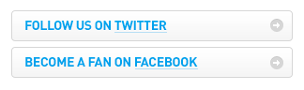
Buttons
Start your 30 day FREE Trial
TRY IT FOR FREE
VIEW FEATURES
Download Now
Buy It
50%
OFF
Version 2.3-Mac OS X 10.8
CREATE NEW ACCOUNT
+
Learn more about what we offer
Take a FREE Trial Today
or Sign In to an existing account
Download
Buy
Add to Cart
Add to Cart
Continue Registration
Try it for FREE
No Credit Card Required
DOWNLOAD
BUY
FOLLOW US ON TWITTER
or LEARN MORE
→
BECOME A FAN ON FACEBOOK
See Plans and Pricing
30-day Free Trial. Quick sign up.
Sign Up Now!
Only Takes 2 Minutes
Free Account Available
Sign Up Now
30 Day free trial
Download
BUY
BUY NOW
$99^{.95}
30-day free trial for Windows (need Mac OSX?)
FREE SHIPPING!
New
SIGN UP NOW
for a 30 day free trial
SIGN UP NOW
TRY THE DEMO
TRY IT NOW, FREE!
SIGN UP NOW
watch the video

Slide 13
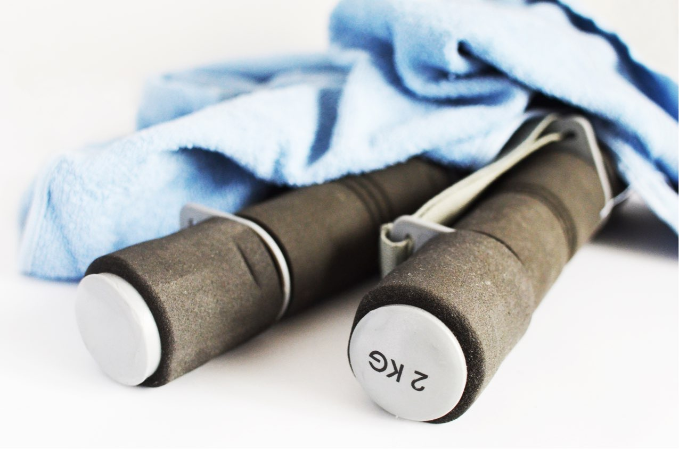
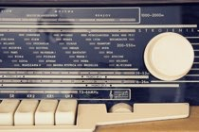
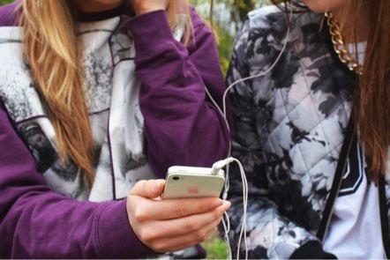
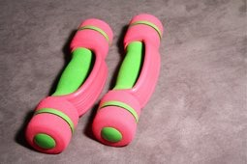
Shopping Cart
Cart: 2 items (2 orders)
Shopping Cart
Item added! It’s below in your order from FashionMaker.
Checkout
Need Help? See our online Faqs.
Continue Shopping
Begin Checkout
Medium Dress 2-3T Blue Yellow $50.00
X remove
Subtotal (without shipping): $50.00
Keep Shopping
Order from CompTrade
Items in Your Cart
Image Item Description Qty Price Total
BrandH ClearV 32” Widescreen LCD HDTV in Black $ 527.00 $ 527.00 remove
Model TT5891
Availability: In Stock
1
Medium Dress 2-3T Blue Yellow $77.00
Subtotal (without shipping): $77.00
Order from FashionMaker
Ship to Zip: 73988 Edit
Select your shipping method:
Processing time = 1-24h
Shipping time = 3-5 Business Days
List of shipping methods
Have a special offer
If you have a promotion code, please enter it here:
1
Cart Subtotal $ 527.00
Your Shipping FREE
Taxes $0.00
------------------------------------------
Order Total $ 527.00
SHOPPING CART
Product Details
Qty
Options
Price
Continue Shopping
Begin Checkout
Crosby Jacket
Smog (M)
1
Edit
Remove
Save to Wish-list
$89.00
Please review your order
Item Name Description Price Quantity Total
Promotion Code
Christmas277
Apply
The Lovely Crush Description of the pro... $12.00 1 = $12 remove
Sub Total: $408.95
Shipping:
Handling:
Sales Tax:
Order Total: $408.95
The Lovely Crush Description of the pro... $12.00 1 = $12 remove
update
Cost before shipping = $24.00
Check Out
Almost There
Orders over $50 get free shipping!
Continue shopping or Go to checkout

Slide 14
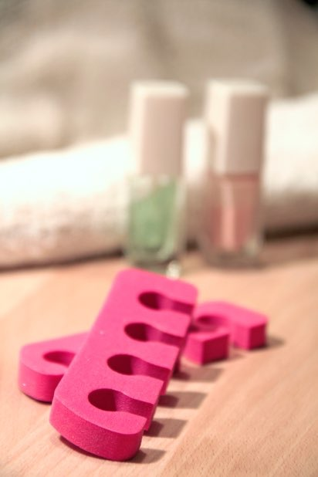

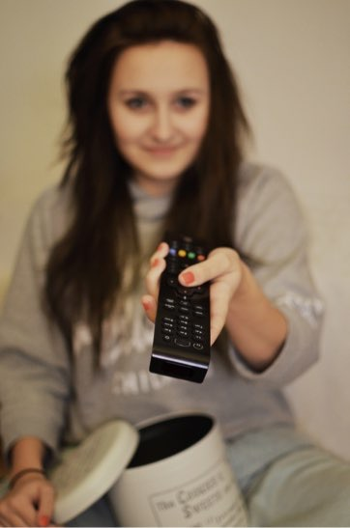
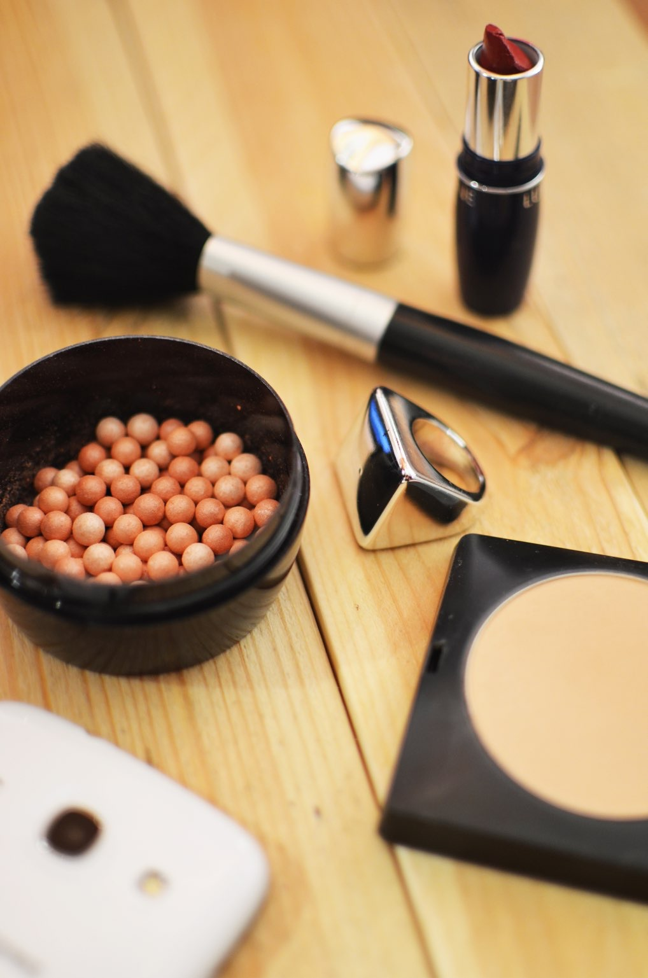


Shopping Cart
2 items in your cart
CLOSE
Summer Sandals
K66329
Color: Purple
Size: 7 Price: $140.00
2 Item(s)
JUST ADDED TO YOUR SHOPPING BAG
Previously Added Items
Summer Sandals
K66329
Color: Purple
Size: 7
Summer Sandals
K66329
Quantity: 1
Price: $34.00
Summer Sandals $71.99
Quantity: 1
Sub Total: $240.00
remove
Edit Cart
Checkout
Summer Sandals $71.99
Quantity: 1
You Have 2 Total Items In Your Bag SUBTOTAL: $73.50
remove
Back to Shopping
Proceed to Cart
0
Search
Sing in
Gift Cards
Wish list
Cart
Subtotal: $143.98
Edit Cart
Checkout Now
Cart (1)
Checkout
Pretty Jacket
Close
QUANTITY: 1
CovGrl & Aleey
Simple AntiAge
Foundation
(15 shades available)
0.4oz Creamy Natural
Qty: 1
$13.99
COLOR: Smog
VIEW CART
SIZE: M
LIST PRICE: $90.00
ITEM TOTAL: $90.00
Your Order
SUBTOTAL (1 ITEM) $90.00
QTY
PRODUCT NAME
PRICE
TOTAL
REMOVE
1
Zippo Lighter
20.00$
20.00$
REMOVE
Free Standard Shipping On All Orders Over $100
1
Zippo Lighter
20.00$
20.00$
REMOVE
Merchandise Total: $13.99
Standard Delivery $5.00
Estimated Tax: $0.00
------------------------------------------------
Order Total: $18.99
VIEW CART AND CHECKOUT
Update
Top sellers
Total 30.00$
Checkout
Continue shopping
Continue
Shopping
Checkout
Advertisement Space
Some Chapeaux
$13.00
Some Wall Mounts
$11.55
Crazy Cool Shirt
$28.06

Slide 15

eCommerce
Products Matched: 17 I Sort by: Most Relevant I 1 of 2 > I Per page: 16
All Products (94)
Items on Sale (22)
Closeout Items (3)
shop for a wine
Prev
1
2
3
4
Next
Show
24
per page
Sort by
Featured
SEARCH RESULTS
Sort by
Featured
Page: Previous I 1 I 2 I 3 I 4 I Next
Cortech
Adrenaline Gloves
MSRP $119.99
$107.99
★ ★ ★ ★ ★
Cortech
Adrenaline Gloves
MSRP $119.99
$107.99
★ ★ ★ ★ ★
Cortech
Adrenaline Gloves
MSRP $119.99
$107.99
★ ★ ★ ★ ★
Cortech
Adrenaline Gloves
MSRP $119.99
$107.99
★ ★ ★ ★ ★
Red Blend
2001 Clos Erasmus
A wine of great intensity, this 415-case blend of 78% Grenache, 17% Cabernet Sauvignon... read more
$199.⁹⁹
Patterned Neoprene
Gourmet Getaway Tote
$24.99
★ ★ ★ ★ ★
Patterned Neoprene
Gourmet Getaway Tote
$24.99
★ ★ ★ ★
Patterned Neoprene
Gourmet Getaway Tote
$24.99
★ ★
Patterned Neoprene
Gourmet Getaway Tote
$24.99
★ ★ ★ ★ ★
Add to Shopping Cart
Red Blend
2001 Clos Erasmus
A wine of great intensity, this 415-case blend of 78% Grenache, 17% Cabernet Sauvignon... read more
$199.⁹⁹
Add to Shopping Cart
Patterned Neoprene
Gourmet Getaway Tote
$24.99
★
Patterned Neoprene
Gourmet Getaway Tote
$24.99
★ ★ ★
Patterned Neoprene
Gourmet Getaway Tote
$24.99
★ ★ ★ ★ ★
Patterned Neoprene
Gourmet Getaway Tote
$24.99
★ ★ ★
Red Blend
2001 Clos Erasmus
A wine of great intensity, this 415-case blend of 78% Grenache, 17% Cabernet Sauvignon... read more
$199.⁹⁹
Add to Shopping Cart
Compare
Add to Cart
Compare
Add to Cart
Compare
Add to Cart
Compare
Add to Cart
Red Blend
2001 Clos Erasmus
A wine of great intensity, this 415-case blend of 78% Grenache, 17% Cabernet Sauvignon... read more
$199.⁹⁹
Cortech
Adrenaline Gloves
MSRP $119.99
$107.99
★ ★ ★ ★ ★
Cortech
Adrenaline Gloves
MSRP $119.99
$107.99
★ ★ ★ ★ ★
Cortech
Adrenaline Gloves
MSRP $119.99
$107.99
★ ★ ★ ★ ★
Cortech
Adrenaline Gloves
MSRP $119.99
$107.99
★ ★ ★ ★ ★
Add to Shopping Cart
Patterned Neoprene
Gourmet Getaway Tote
$24.99
★ ★ ★ ★
Patterned Neoprene
Gourmet Getaway Tote
$24.99
★ ★ ★ ★ ★
Patterned Neoprene
Gourmet Getaway Tote
$24.99
★ ★
Patterned Neoprene
Gourmet Getaway Tote
$24.99
★ ★ ★ ★
Compare
Add to Cart
Compare
Add to Cart
Compare
Add to Cart
Compare
Add to Cart

Slide 16
Pricing Tables
Monthly
1 Year (-15%)
2 Years (-30%)
Trial
Free for 30 Days
Business
$99 per month
Team
$49 per month
Solo
$24 per month
Gold
$49/mo
Up to 4 Operators
CRM Integration
SSL Security
Ultimate
$243/mo
Up to 15 Operators
CRM Integration
SSL Security
Groups
White Label
Phone Support
Platinum
$129/mo
Up to 8 Operators
CRM Integration
SSL Security
Groups
White Label
Best Value
Bronze
$17/mo
1 Operator
CRM Integration
Active Projects
15
35
15
5
File Storage
1GB
5GB
5GB
500MB
Site Branding
✓
✓
✓
---
Users
Unlimited
Unlimited
Unlimited
Unlimited
Try!
Sign Up!
Sign Up!
Sign Up!
Sign Up!
Sign Up!
SIGN UP
Sign Up!
Annual Promotion
Get 12 for price of 11!
---
Buy Now
$1089 Yearly
Buy Now
$539 Yearly
Buy Now
$264 Yearly

